Slide 1
Calibrating PM 2.5 Values From Low-Cost Sensors using values from Reference Grade Monitors
Using Machine Learning Methods
Name: Kunal Jalindar Gaikwad
Date: 12/13/2022

Slide 2
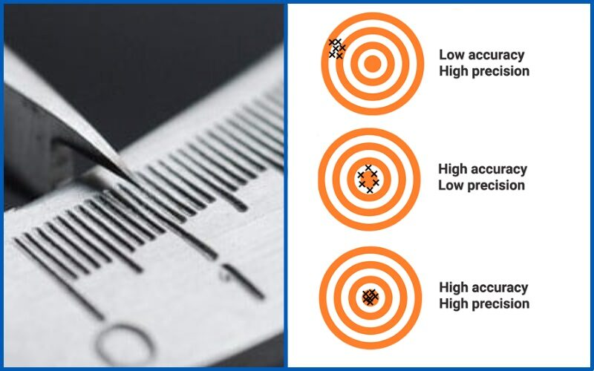
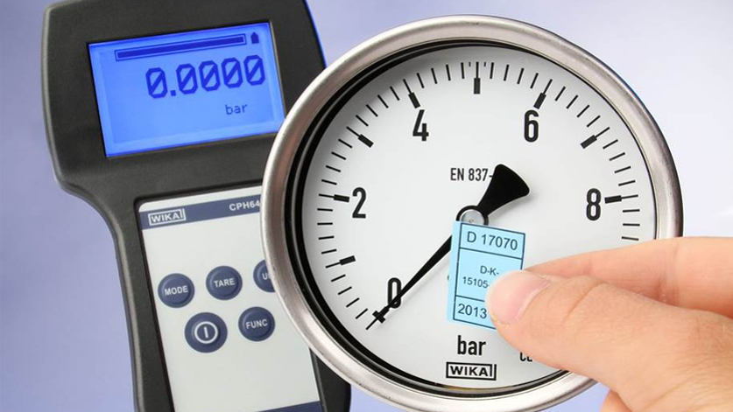
Calibration
Calibration is the comparison of measurement values delivered by a device under test with those of a calibration standard of known accuracy. Such a standard could be another measurement device of known accuracy,
A reverse process to regression, where instead of a future dependent variable being predicted from known explanatory variables, a known observation of the dependent variables is used to predict a corresponding explanatory variable.
Image ref:-
https://blog.wika.com/knowhow/verification-or-calibration/?doing_wp_cron=1671143669.2394099235534667968750
https://soluzionesolare.com/guides/difference-between-calibration-adjustment-accuracy-and-precision/

Slide 3
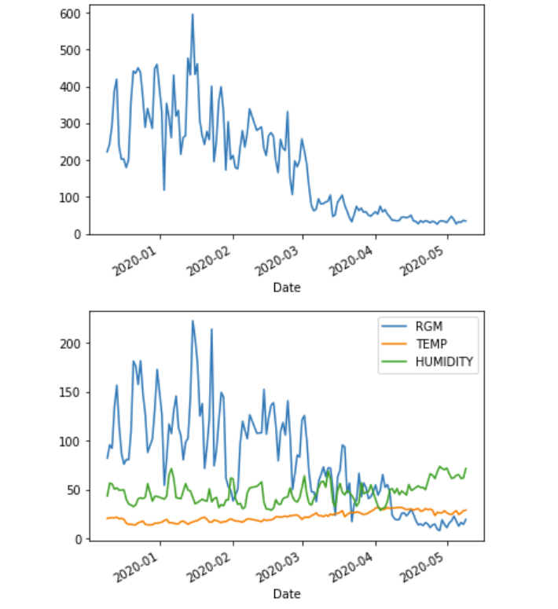
Visualizing the Data
LCS - Predictant
Model
RGM Values, Temperature, Relative Humidity - Predictor
Time Period of Dataset:- Dec 12, 2019 to May 15 , 2020

Slide 4
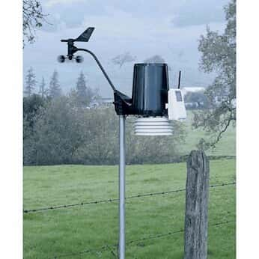
Learning Calibration
Datasets used :
Low-Cost Sensor (LCS) Hourly Dataset
Reference Grade Monitor (RGM) Daily Dataset
For Location
The problem of Calibration of Low-Cost Sensors is as follows
Given ‘n’ days:
(a) W ∈ R^{n×d1} … d1 = features describing daily weather and RGM values.
(b) Z ∈ R^{n} … column vector with LCS as features.
Objective:
At a given timestep t, predict the LCS value matrix Z ∈ R^{n}, given the temperature and RGM values matrix W ∈ R^{n×d1} at that time.
Solution:
Estimate a function, F(Wi) = Zi
.
Image ref:-
https://www.coleparmer.com/i/davis-instruments-6162-plus-wireless-weather-station-uv-solar/

Slide 5
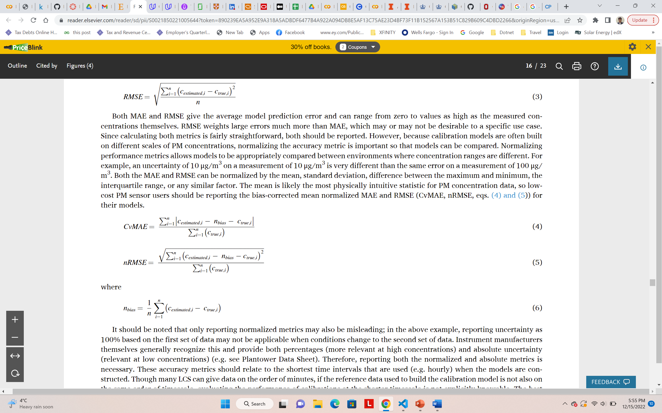
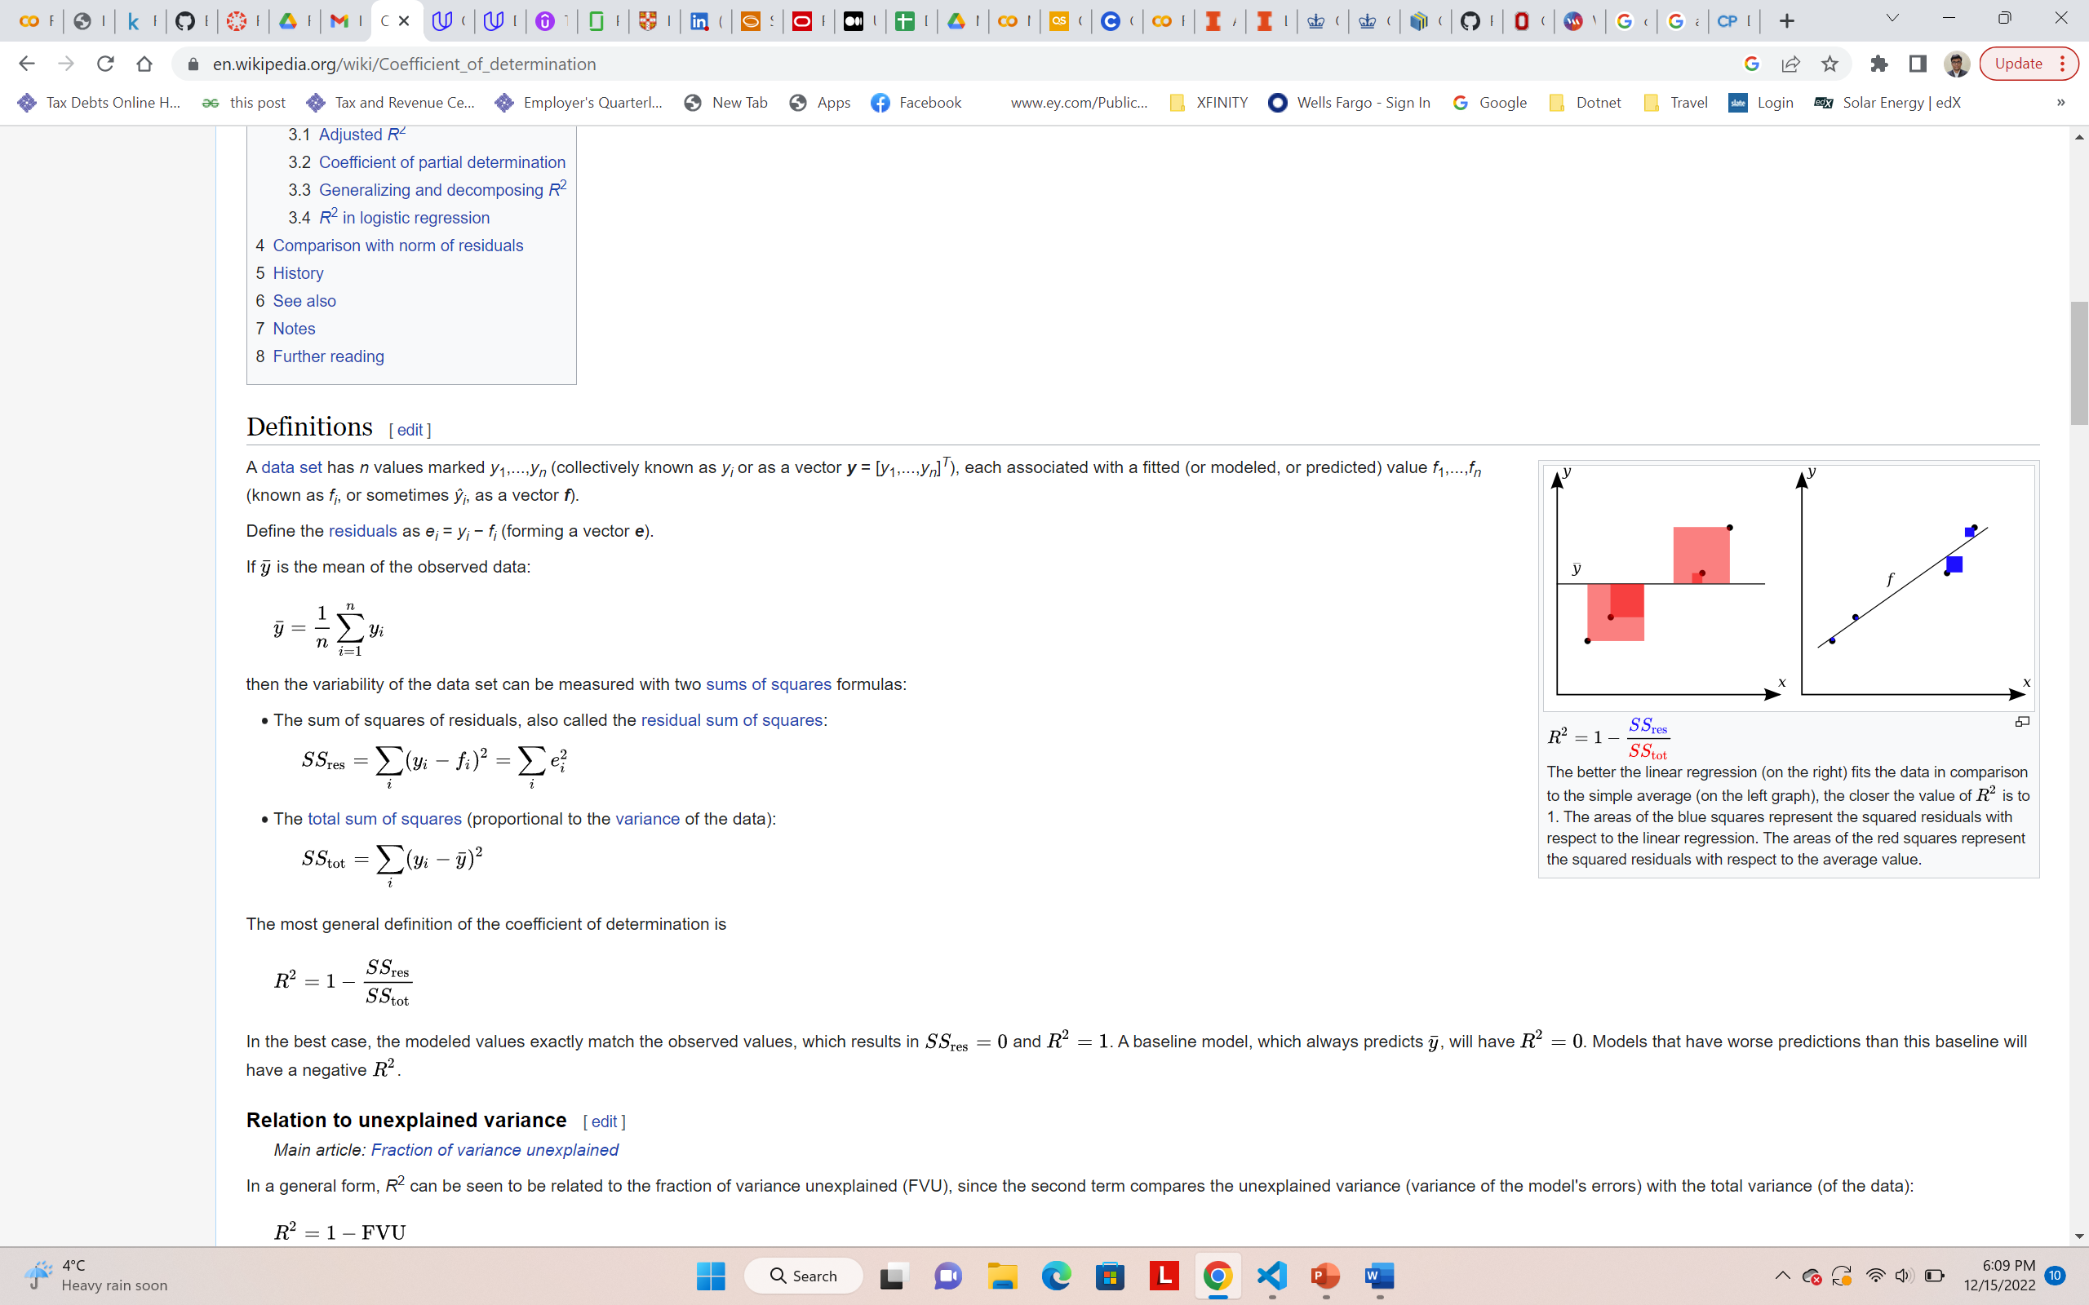
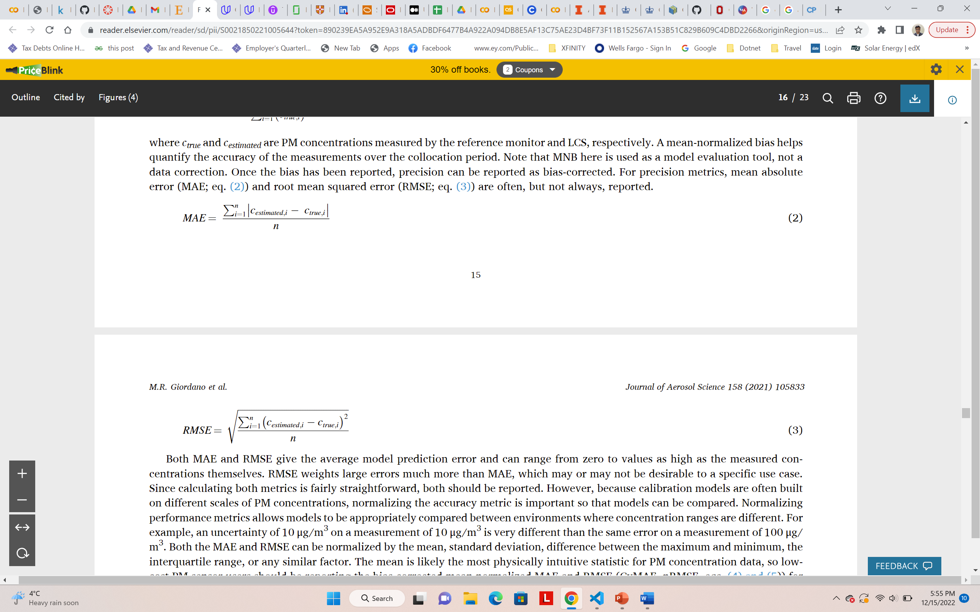
Evaluating the Performance of Models
The performance metrics used in the study are as follows:-
Root Mean Square Error & Bias-corrected mean-normalized RMSE
R2 score ( Coefficient of determination)
Mean Absolute Error & Bias-corrected mean-normalized MAE
Image ref:-
https://www.sciencedirect.com/science/article/pii/S0021850221005644
https://en.wikipedia.org/wiki/Coefficient_of_determination

Slide 6
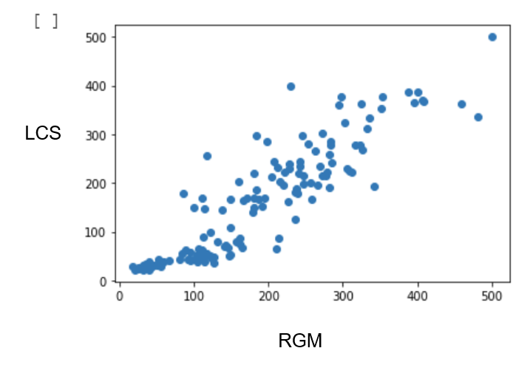
Preprocessing
Preprocessing was done by converting both datasets to daily average values for LCS and RGM Values.
Further, both datasets were scaled using Minmax scaling so that the values of both datasets range from 0 to 500.

Slide 7
Machine Learning Models
KNN Regressor
Cluster Based
Tree Based
Neural networks
Decision Trees
Random Forests
ML Models
Linear
Methods
Statistical
Methods
Gaussian process regressor
Linear Regression
Elastic Net Regression
Support Vector Regression

Slide 8
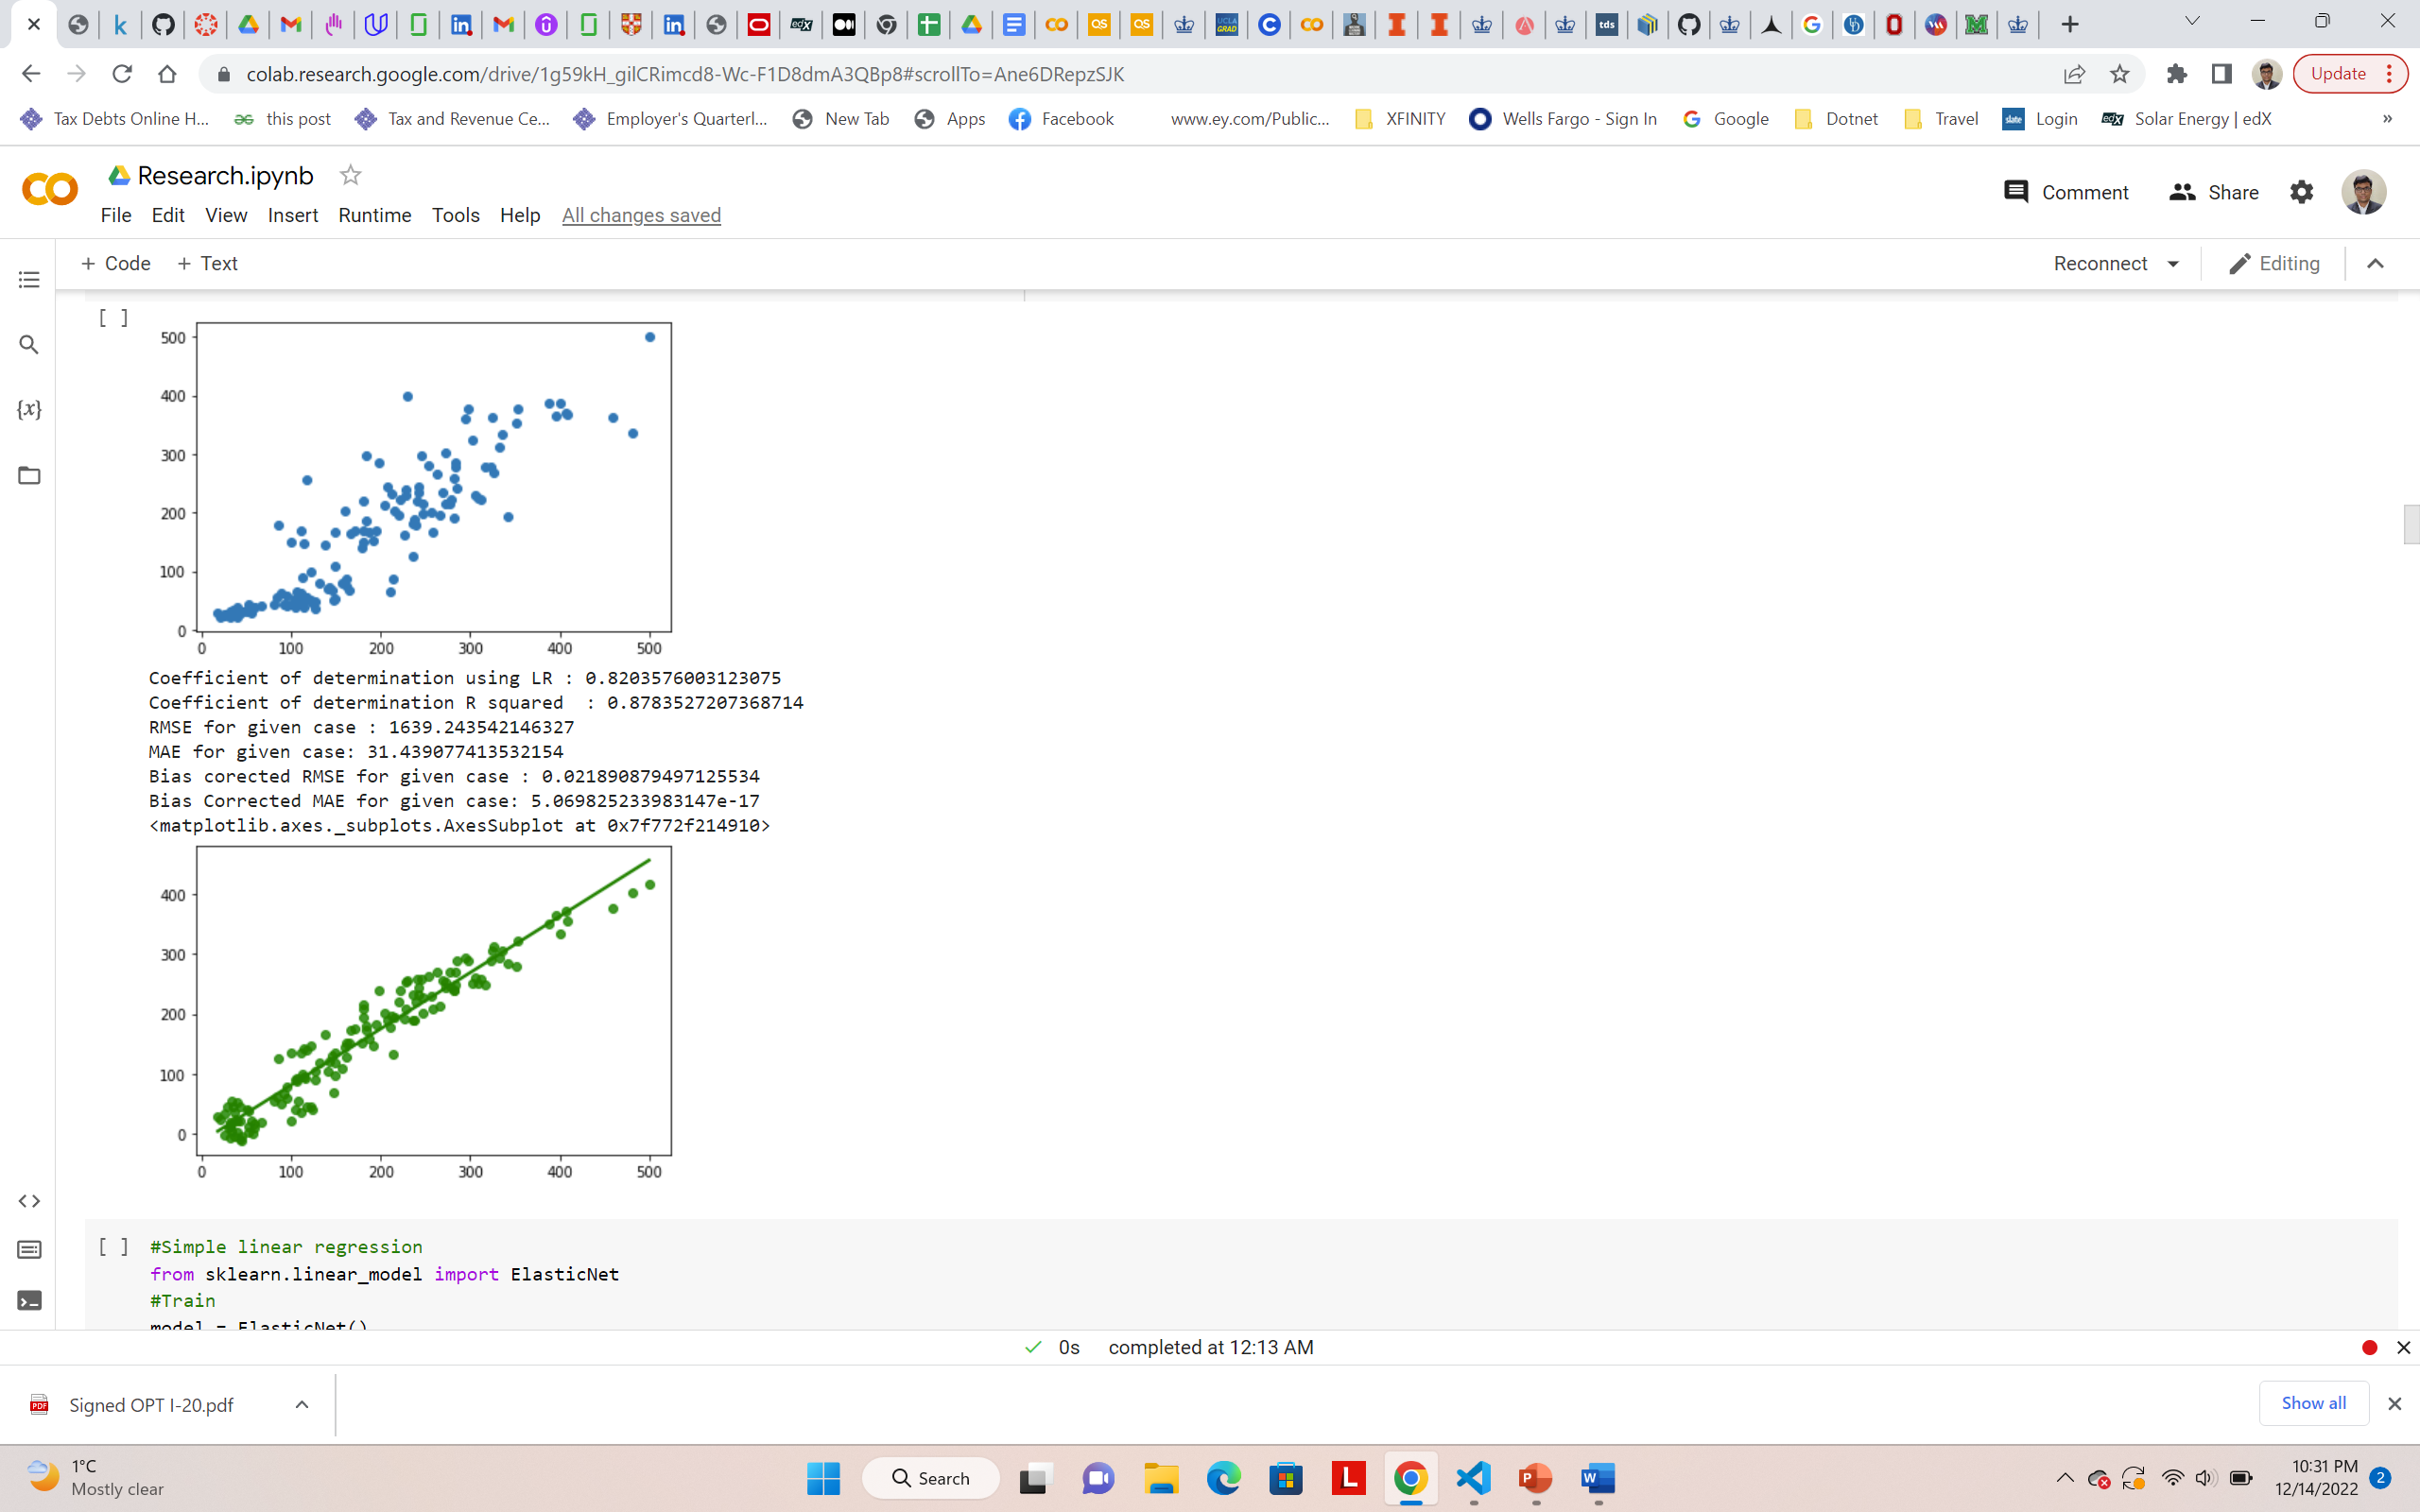
Multiple Linear Regression
LCS
LCS
RGM
RGM
Uncalibrated data
Calibrated using Multiple Linear Regression

Slide 9
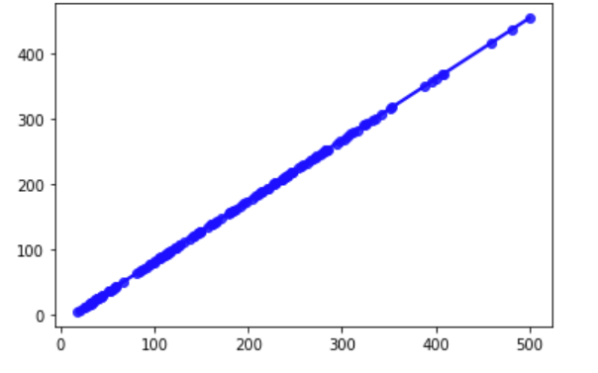
Elastic Net Regression
LCS
LCS
RGM
RGM
Uncalibrated data
Calibrated using Elastic Net Regression
Hyperparameters - {"max_iter": [1, 5, 10,25,100,200],
"alpha": [0.0001, 0.001, 0.01, 0.1, 1, 10, 100],
"l1_ratio": np.arange(0.0, 1.0, 0.01)}

Slide 10
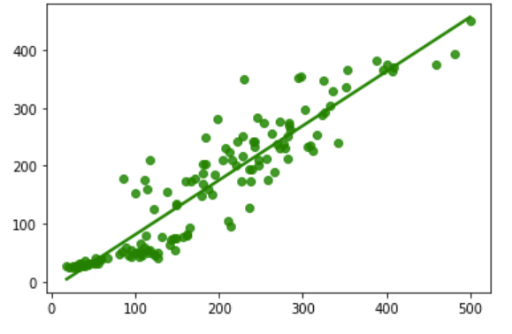
Random Forest Regression
LCS
LCS
RGM
RGM
Uncalibrated data
Calibrated using Random Forest Regression
Hyperparameters -,n_estimators1 = [int(x) for x in np.linspace(start = 200, stop = 2000, num = 10)],max_features1 = ['auto', 'sqrt']
max_depth1 = [int(x) for x in np.linspace(10, 110, num = 11)],min_samples_split1 = [2, 5, 10],min_samples_leaf1 = [1, 2, 4],bootstrap1 = [True, False]

Slide 11
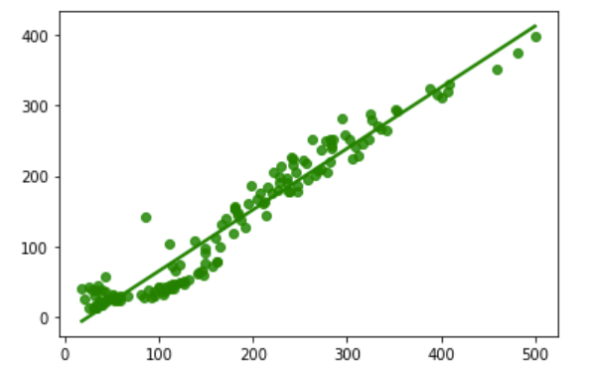
Neural Networks
LCS
LCS
RGM
RGM
Uncalibrated data
Calibrated using Neural Networks
Hyperparameters - learning_rate=0.0001, beta_1=0.99, beta_2=0.999,epochs=50, batch_size=32,validation_split=0.15, number_of_nodes_per_layer=200, number_of_layers=9, activation='relu'

Slide 12
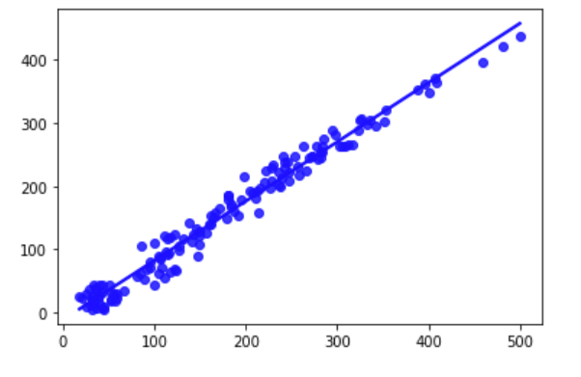
Support Vector Regression
LCS
LCS
RGM
RGM
Uncalibrated data
Calibrated Support Vector Regression
Hyperparameters - {'C': [0.1, 1, 10, 100, 1000],'gamma': [1, 0.1, 0.01, 0.001, 0.0001],'kernel': ['linear'] }

Slide 13
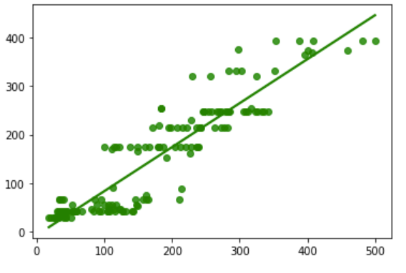
Regression Trees
LCS
LCS
RGM
RGM
Uncalibrated data
Calibrated using Regression Trees
Hyperparameters - {'decisiontreeregressor__max_depth': range(1,20),'decisiontreeregressor__max_features': range(1, 5),'decisiontreeregressor__min_samples_leaf': range(1, 5)}

Slide 14
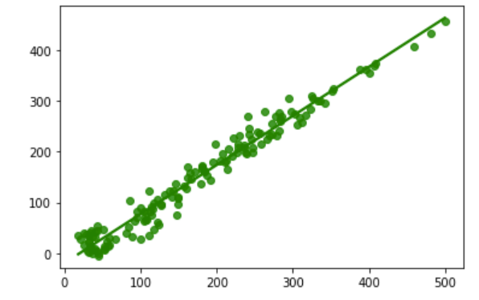
Kernel-Ridge Regression – Linear Kernel
LCS
LCS
RGM
RGM
Uncalibrated data
Calibrated using Kernel-Ridge Regression – Linear Kernel
Hyperparameters - alpha=1.52,kernel='linear'

Slide 15
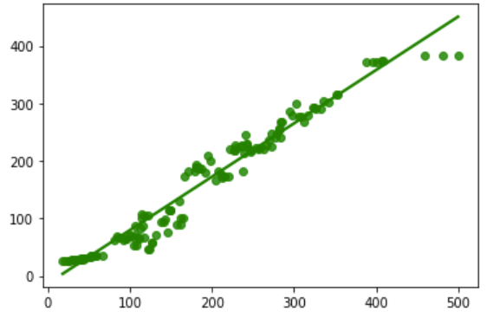
K-Nearest Neighbors Regression
LCS
LCS
RGM
RGM
Uncalibrated data
Calibrated using K-Nearest Neighbors Regression
Hyperparameters - leaf_size = list(range(1,10))
n_neighbors = list(range(1,10))
p=[1,2]

Slide 16
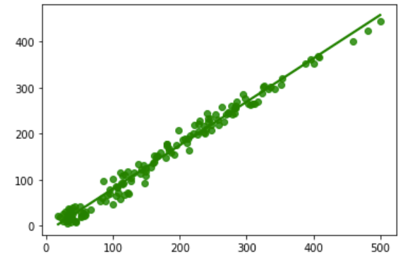
Gaussian Process Regression
LCS
LCS
RGM
RGM
Uncalibrated data
Calibrated using Gaussian Process Regression
Hyperparameters - kernel=DotProduct+WhiteKernel,random_state=200,n_restarts_optimizer=10,alpha=0.025

Slide 17
Results
Model | R2 Score | MAE | Bias-Corrected MAE | RMSE | Bias-Corrected RMSE
Multiple Linear | 0.87835272073687 | 31.439077413532154 | 5.069825233983e-17 | 1639.243542146327 | 0.02189087949712553
Elastic net | 0.82029833769955 | 35.702603897544 | 4.5425634096489e-12 | 2421.548523101618 | 1.0227895096866129
Random Forest | 0.9833503950963756 | 9.728650023110072 | -68.68278527573638 | 224.35978414707242 | 1.1594472973548777
Neural Networks | 0.8651274361231321 | 28.944263405188195 | 1.42787659208035e-08 | 1817.459302724297 | 0.02259824765238459
Support Vector | 0.8417385563565789 | 31.20870164212426 | 200.95735156192654 | 1788.8450986230682 | 1.7069897756749888
Regression Trees | 0.993998722238167 | 3.807009551195655 | 0.23984522983123 | 80.86950957967669 | 1.0745660505547563
Kernel Ridge | 0.8365606921755824 | 32.5573688196638 | 4.10121666915722e-17 | 1964.6199620671018 | 0.0242156247257755
KNN | 0.8283995337062441 | 28.73734955220596 | -1.026896264332e-17 | 1919.1974902793347 | 0.02396552721517065
Gaussian Process | 0.834467358741199 | 31.56940244032075 | 3.0457059880332e-17 | 1868.7144363279638 | 0.0234019714235519

Slide 18
Conclusions
Regression Trees outperform all other models in all except one metric – Bias Corrected RMSE.
Gaussian Process Regression outperforms in Bias Corrected RMSE.
Multiple linear regression gives good results, despite being the simplest method being used.
Elastic Net Regression provides the best linear fit among all models.
Tuning the hyperparameters better could yield better results.
Incorporating more regression models – Long Short-Term Memory Neural Networks, Polynomial Regression, etc.
More performance metrics could be evaluated for a thorough analysis of all models.
Future predictions could be made using the already available time series data.

Slide 19
Google Colaboratory Notebook links
https://colab.research.google.com/drive/1Wc2aQuKnh5T270-bI9uvQKY2RS0YYw0J#scrollTo=tgvmwBF_CE4M
https://colab.research.google.com/drive/1Y3UVWEeNrUkN1jLxcPA9ziwjG1E9QnA5#scrollTo=mMS3if3i08yd
https://colab.research.google.com/drive/1g59kH_gilCRimcd8-Wc-F1D8dmA3QBp8#scrollTo=R2kauHlgnqNN

Slide 20
THANK YOU!

